Slide 1
Teaching pronunciation: choosing an approach
IATEFL Conference - Glasgow 2017
Piers Messum
Pronunciation Science Ltd
www.pronsci.com
Notes:
Talk about three approaches: two are LF, one starts with production. Pros and cons of each. (LF is easy to teach …)

Slide 3
antejentacular

Slide 5
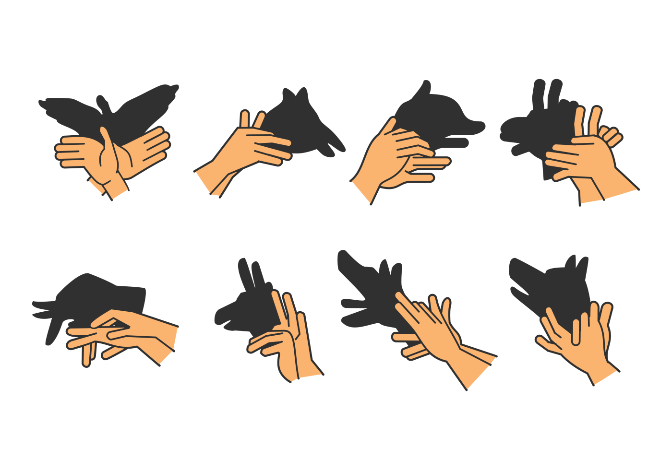

Slide 6
How would you teach someone to make (new) shadow animals?
With these constraints:
Positions are ephemeral
No side by side comparison
Everyone’s hands invisible
Trubetzkoy’s sieve in action!

Slide 7
Conventional pedagogies
The two approaches | Imitative-Intuitive | Analytic-Linguistic
Principal exercises | Listen & Repeat (L&R) | Listen & Say (L&S)
Learning mechanisms | Mimicry (?) | Auditory Matching-to-Target
‘Listen first’
Notes:
Reflexive vs considered
It ought to work …

Slide 8
Does ‘Listen First’ (LF) work?
Can the LF classroom be saved?
Does LF sometimes work?

Slide 9
Does LF work?
The student:
Hears the model as L1; says the L1 sound he heard.
Hears the model as something new; but has no idea what to do to make it, and so says nothing.
Hears the model as something new; commits himself to holding on to it … which gives him no time or freedom to work on articulation. He may make a ‘stab’ at doing something new, but (even if he’s successful) this is not sufficiently considered or practised to still be available outside the classroom.

Slide 10
Can the LF classroom be saved?
Could intense perceptual training (e.g. HVPT) help in the general classroom? No:
Too time intensive
Needs motivated students
Not all are successful; of those who are, only about half have improved production
Notes:
Don’t know how to move out of L1 motor routines by being present to what they do
Go for different

Slide 11
When LF does work
Hear model of L2 sound
Reconceive as
L2 sound
Set aside L1; hear as noise
Noises made and matched

Slide 12
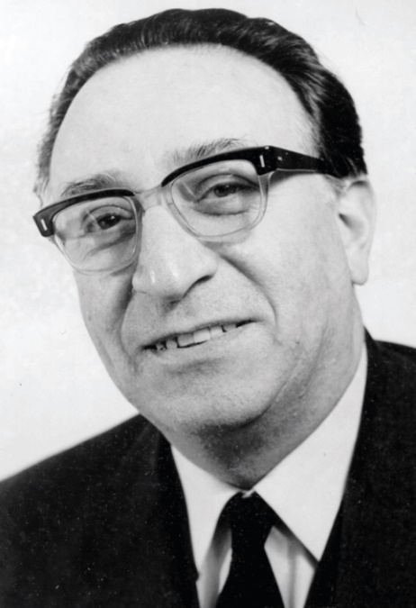
The Articulatory Approach

Slide 13
A third approach | Articulatory Approach
Principal exercises | Say* and attend to the teacher’s feedback | Say* & Listen (S&L)
Learning mechanisms | Motor experimentation, with information about the results
*(and feel/listen)
Notes:
Reflexive vs considered
It ought to work …

Slide 15
Demo: Teacher as coach
‘Silent’ teacher (non-modelling)
Coaching paradigm
Trial, error and feedback
Articulatory setting
Freedom from an expert voice

Slide 16
Demo: ‘Human computer’*
Student develops a phrase to test
Trial, model from teacher, noticing
Prohibition on repetition, to forestall reflexive copying (where the motor activity is opaque to the learner)

Slide 17
Problems in learning
The perceptual problem (T’s sieve).
A motor skill that is largely invisible.
Audible results that are ephemeral.
Learners are insensitive to their articulators.
The pull of L1 articulation …
… and the awkwardness of moving into L2.

Slide 18
Solution: the Articulatory Approach
Motor experimentation.
Information about the results.

